Slide 1
Computer Vision COMPSCI 760 2024 Semester 1
Olivier Graffeuille ogra439@aucklanduni.ac.nz

Slide 2

Plan
Outline for Weeks 6-11
Week 6: Computer Vision – CNNs
Week 7: Computer Vision – Other vision tasks
Week 8: Transfer Learning
Week 9: Continual Learning
Week 10: Domain Generalisation
Week 11: Self-Supervised Learning

Slide 3
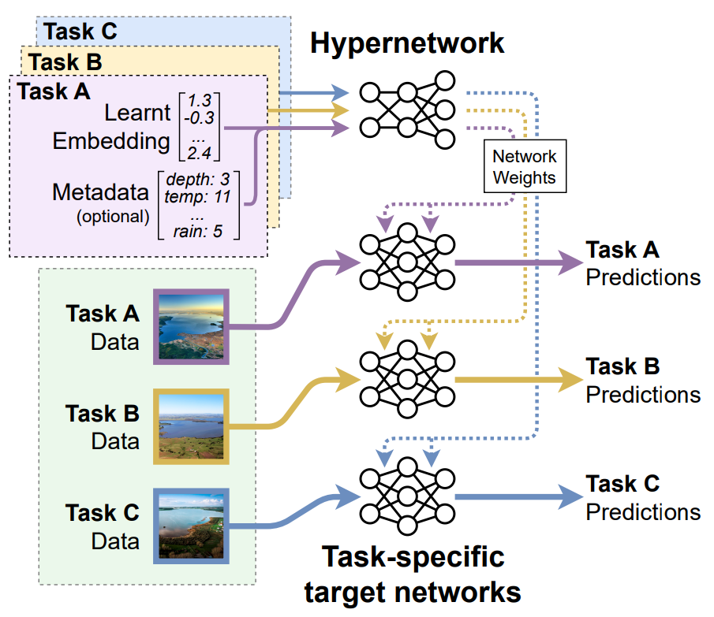
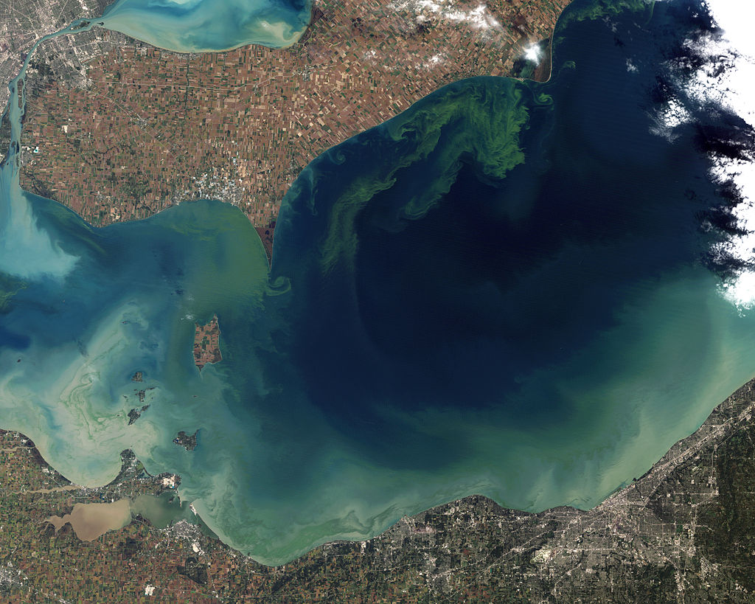
About me
Taken from orbit in October 2011, the worst algae bloom that Lake Erie
has experienced in decades. (ITTNASA)

Slide 4
Background
Disclaimer/Acknowledgment
The following slides are reusing some of the content from the Stanford CS230 and CS231n class: https://stanford.edu/~shervine/teaching/cs-230/ https://cs231n.github.io/convolutional-networks/
Some content is also reused from the CS230 Stanford course slides created by Andrew Ng, available at https://cs230.stanford.edu/syllabus

Slide 5
Outline
Background
Convolution
CNN components: convolutional layers, pooling layers
CNN architectures

Slide 6
Outline
Background
Convolution
CNN components: convolutional layers, pooling layers
CNN architectures

Slide 7
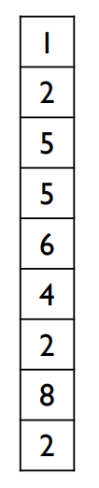
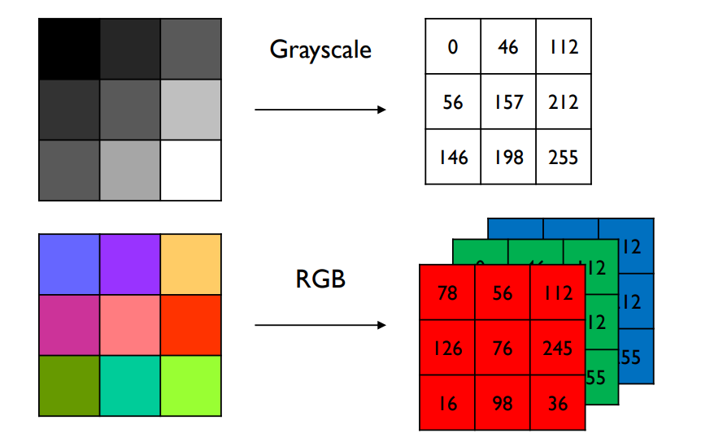
Background
Images as vectors
Neural networks usually take a vector of values as input
A digital image is generally represented as a 2D Matrix of pixels

Slide 8
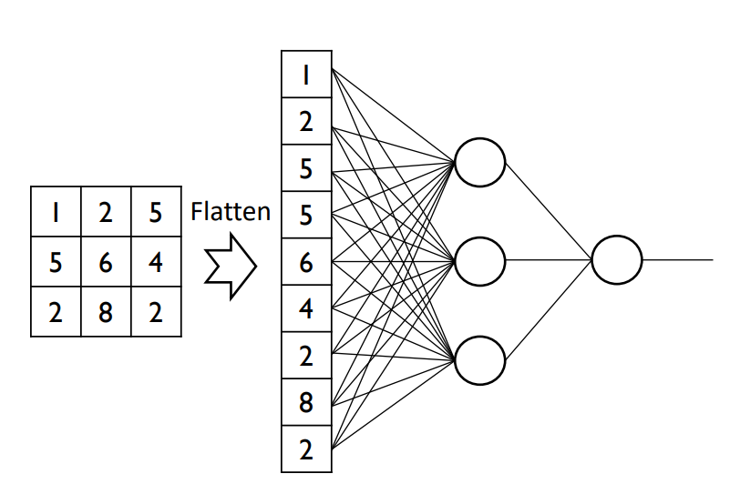
Background
Fully connected layers?
Why not just flatten an image into a vector, and use traditional NNs (with fully connected linear layers) to process an image?

Slide 9
Background
Fully connected layers?
Problem 1: The number of parameters would go quickly:
A 512x512x3 image has 800k values
A linear layer mapping from 800k input neurons to 800k hidden neurons would have 640 billion parameters (more than GPT-4?)

Slide 10
Background
Fully connected layers?
Problem 1: The number of parameters would go quickly:
A 512x512x3 image has 800k values
A linear layer mapping from 800k input neurons to 800k hidden neurons would have 640 billion parameters (more than GPT-4?)
Problem 2: Would lead to overfitting
In a given dataset, potentially: if pixel #14,153 is greener than pixel #784,150 then the image is a cat
The model’s inductive bias is not suitable for images

Slide 11
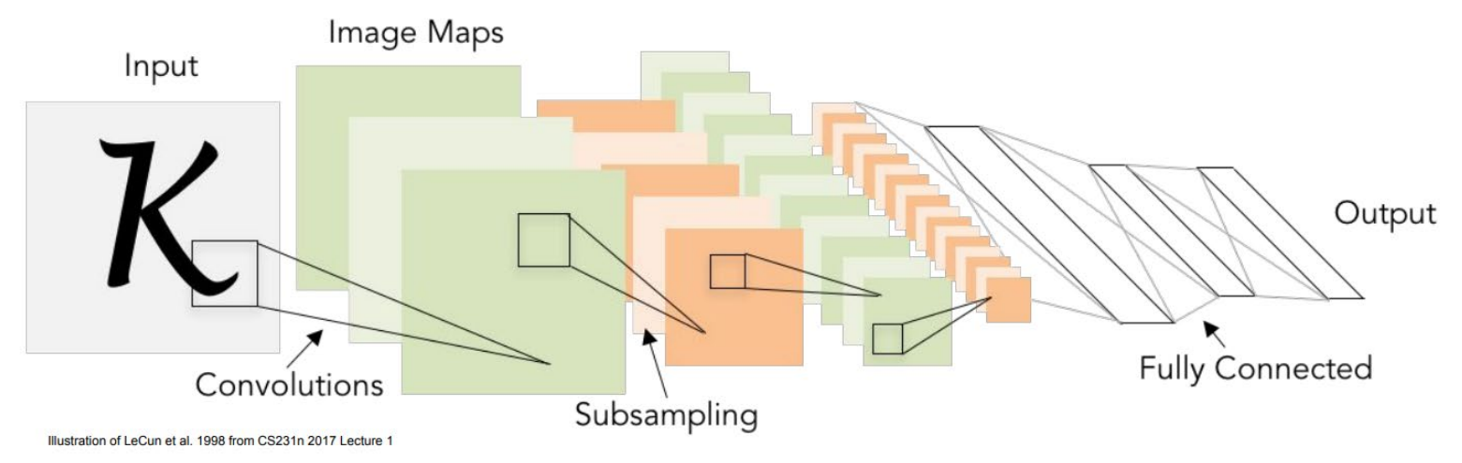
Background
Images as vectors
Instead, we should consider pixel locality

Slide 12
Background
Images as vectors
Main differences with a classic ANN:
Explicit assumption that inputs are images.
Introduce new types of layers: convolution and pooling layers

Slide 13
Background
Images as vectors
The benefits of CNNs:
Make images easier to process
Extract meaningful features from the image.
They are the go-to architecture for computer vision tasks*

Slide 14
Outline
Background
Convolution
CNN components: convolutional layers, pooling layers
CNN architectures

Slide 15
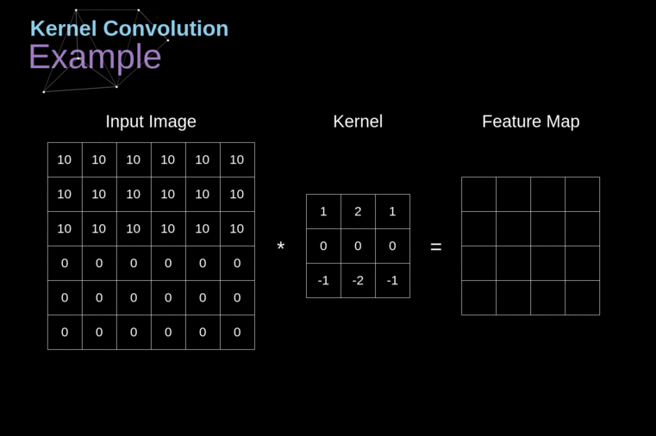
Convolution
Kernels
Convolution is common in image processing to filter images using kernels
Edge detection
https://towardsdatascience.com/gentle-dive-into-math-behind-convolutional-neural-networks-79a07dd44cf9

Slide 16
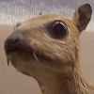
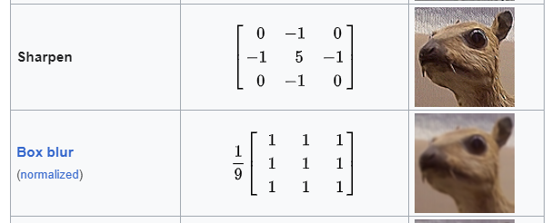
Convolution
Kernels
Convolution is common in image processing to filter images using kernels
Edge detection
Smoothing
https://en.wikipedia.org/wiki/Kernel_(image_processing)

Slide 17
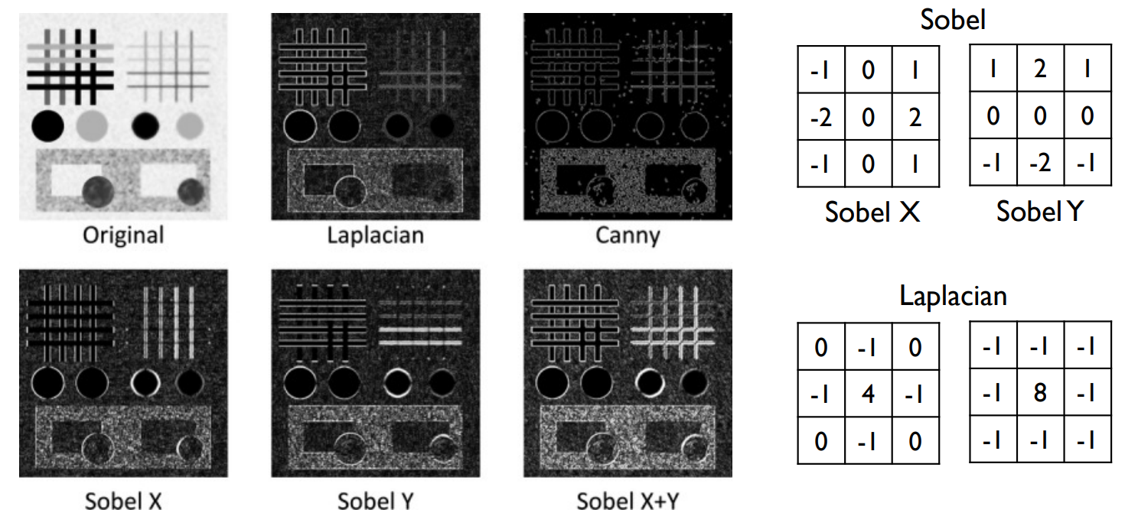
Convolution
Kernels
Convolution is common in image processing to filter images using kernels
Edge detection
Smoothing
Other filters
Uchida, S. (2013). Image processing and recognition for biological images

Slide 18
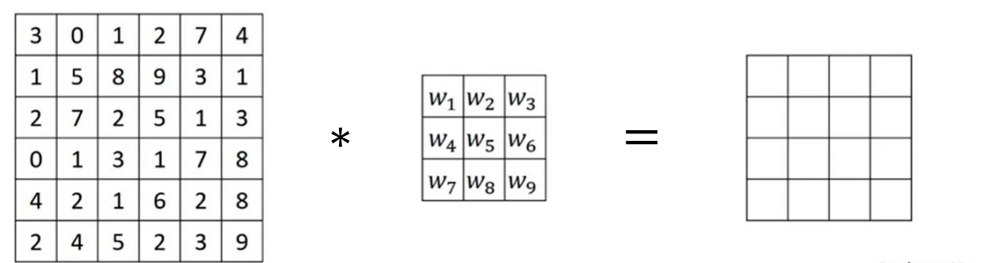
Convolution
Kernels
What filters should we use?
Define them as neural network weights
Learn them through backpropagation

Slide 19
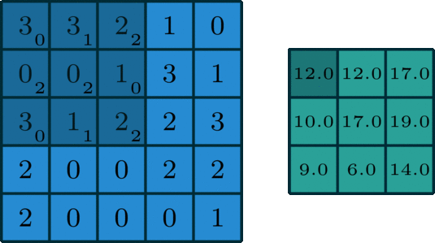
Convolution
Convolutional Layer
Sliding kernel (filter) over the image
Computationally: matrix multiplication + sum
Convolution of a f x f filter with a n x n image produces a n-f+1 x n-f+1 feature map

Slide 20
Convolution
Convolutional Layer
Sliding kernel (filter) over the image
Computationally: matrix multiplication + sum
Convolution of a f x f filter with a n x n image produces a n-f+1 x n-f+1 feature map
Problem: shrinking size, and border pixels don’t contribute much to feature map

Slide 21
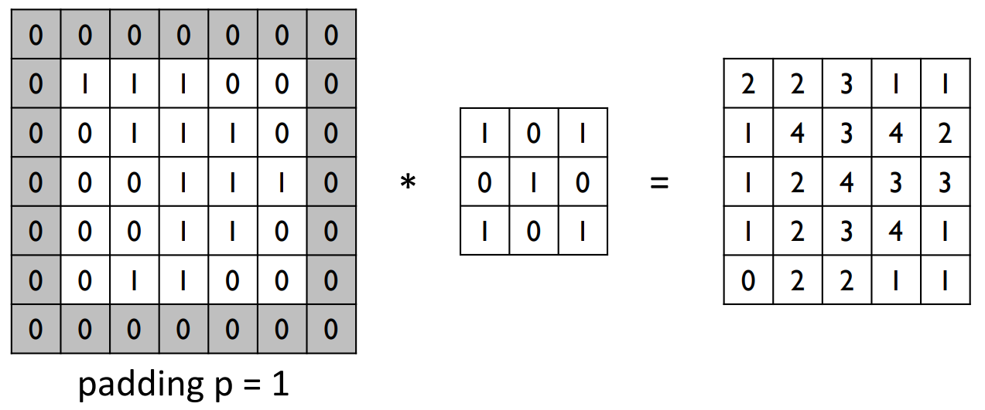
Convolution
Padding
Convolution of a f × f filter with a n × n image, with p padding produces a n+2p–f+1 × n+2p–f+1 feature map

Slide 22
Convolution
Padding
Valid padding (no padding)
Output: n–f+1 × n–f+1 feature map
Same padding (padding to make output feature map the same size as the input)
Output: n+2p–f+1 × n+2p–f+1 feature map
What p should you use? n = n+2p–f+1 p = (f-1) / 2 (depends on filter/kernel size!)
Filter size f is usually odd (3x3, 5x5…) to have integer p

Slide 23
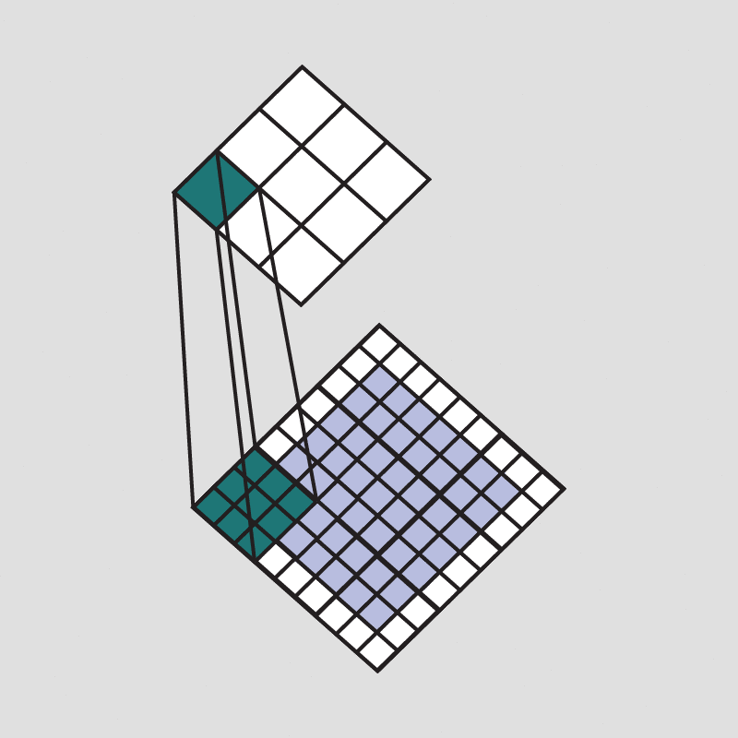
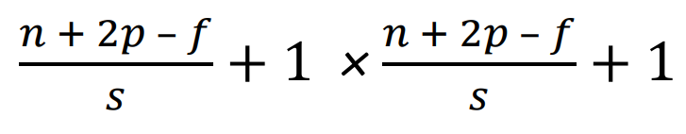
Convolution
Stride
Strided convolutions reduce the size of the output
Convolution of f×f filter on a n×n image with padding p and stride s produces feature map of size

Slide 24
Convolution
Stride
Why use strided convolutions to reduce the size of the output?
Reduces computational load
Increases the receptive field of the features
Alternative to pooling

Slide 25
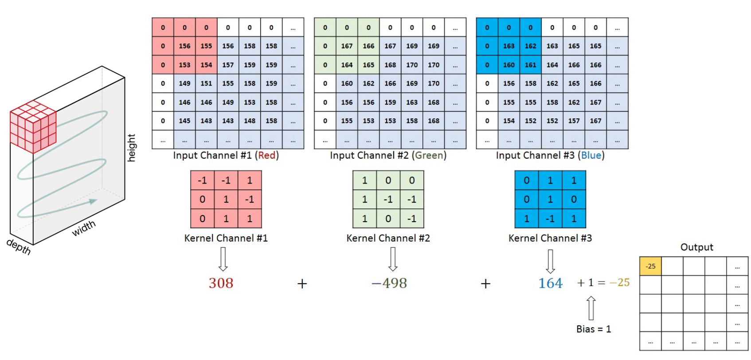
Convolution
Images are 3D tensors

Slide 26
Outline
Background
Convolution
CNN components: convolutional layers, pooling layers
CNN architectures

Slide 27
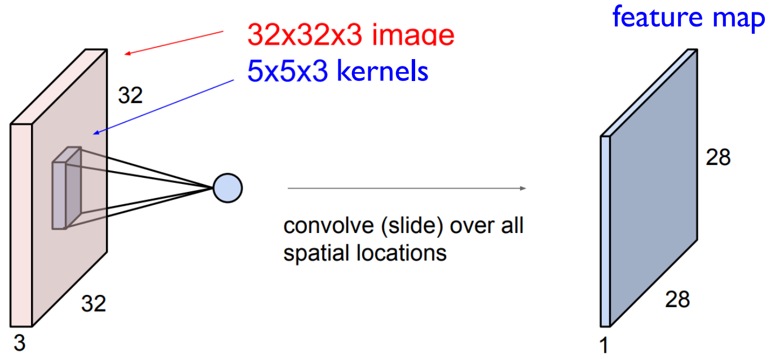
Convolutional Layers
Making a convolutional layer

Slide 28
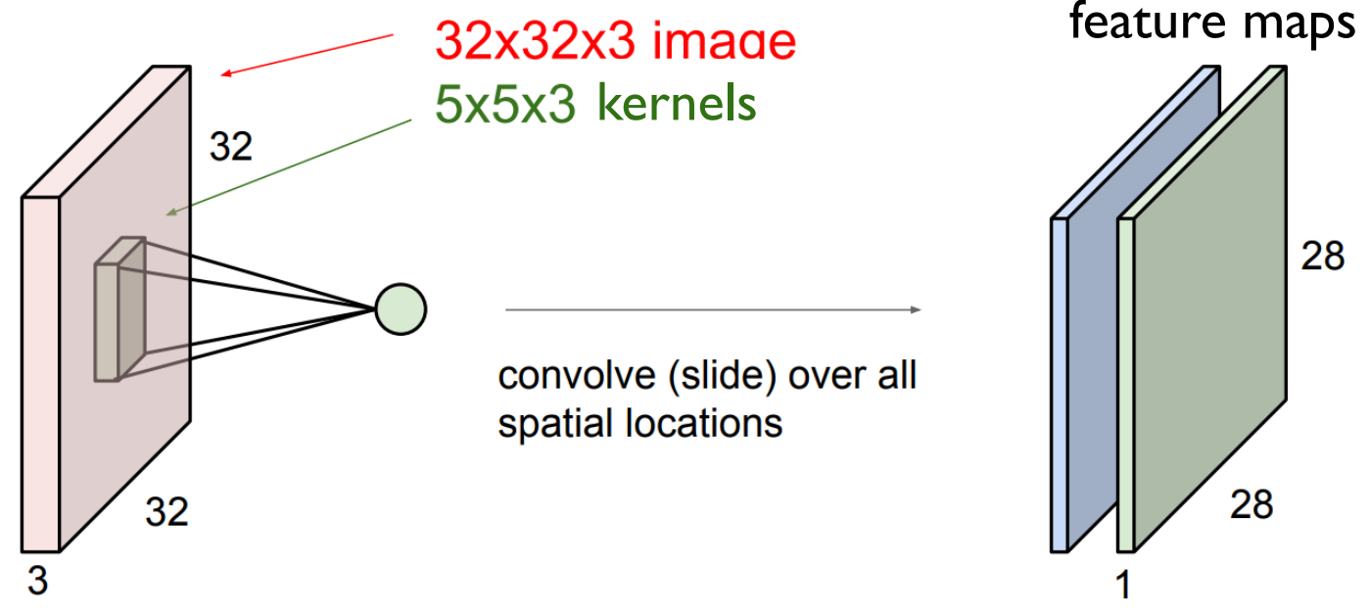
Convolutional Layers
Making a convolutional layer

Slide 29
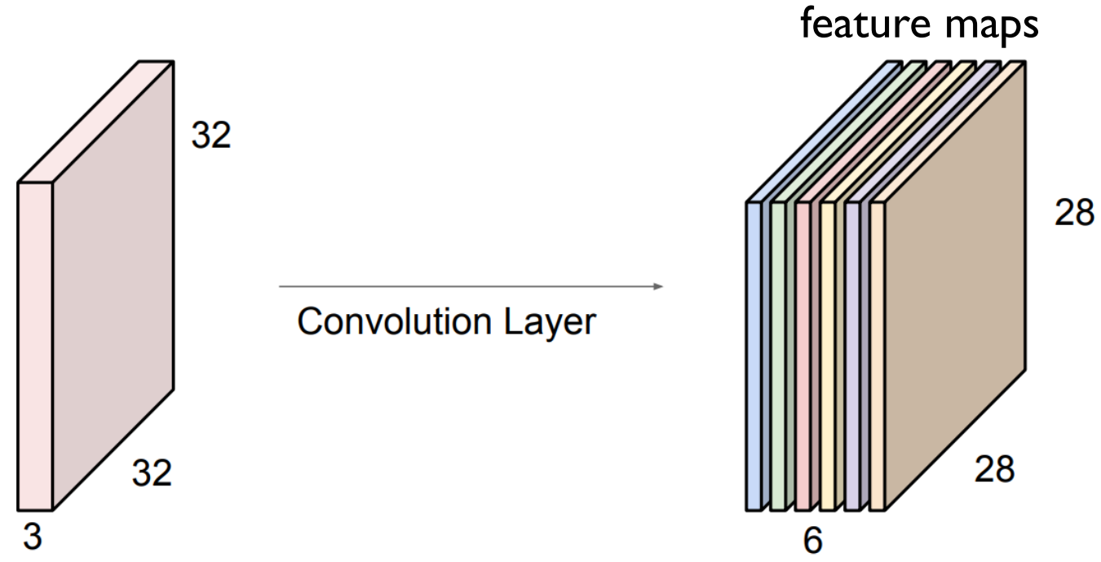
Convolutional Layers
Making a convolutional layer
Stacking multiple kernels produces new 3D “image” (feature map)

Slide 30
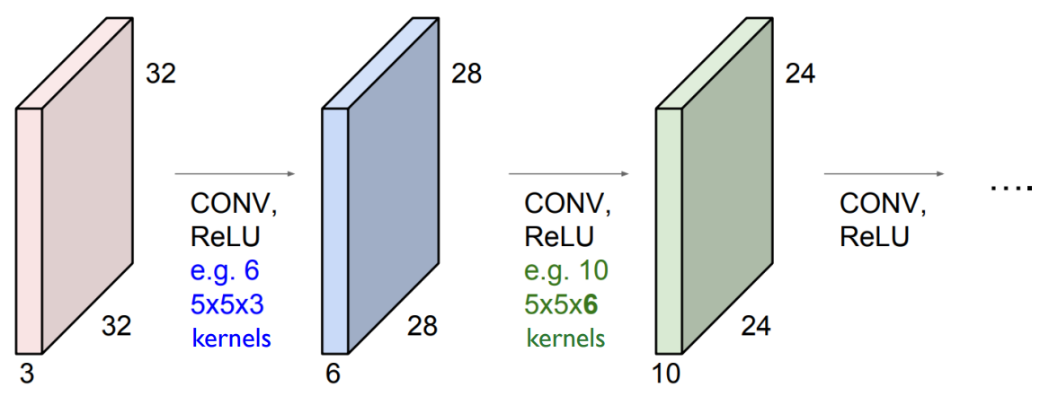
Convolutional Layers
Multiple convolutional layer
Stacking multiple kernels produces new 3D “image” (feature map)

Slide 31
Convolutional Layers
1x1 Convolutions
Many models use 1x1 convolutions, which seems confusing
On a 2D image, a 1x1 convolution is just a scaling factor out = w*in
But since images (and feature maps) are 3D, they are a layer-wise linear transformation

Slide 32
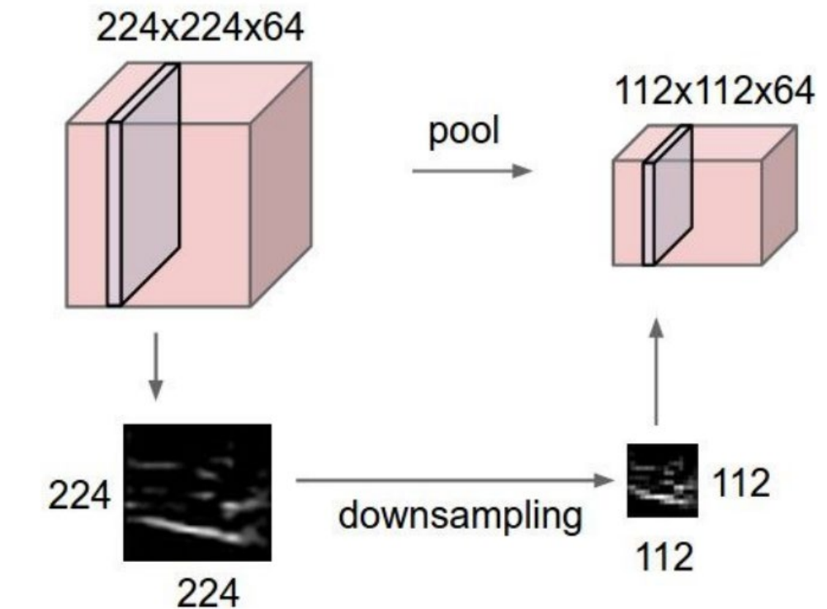
Pooling Layers
Pooling
Makes representations smaller (similar to strides)
Applies independently on each feature map (spatial aggregation)

Slide 33
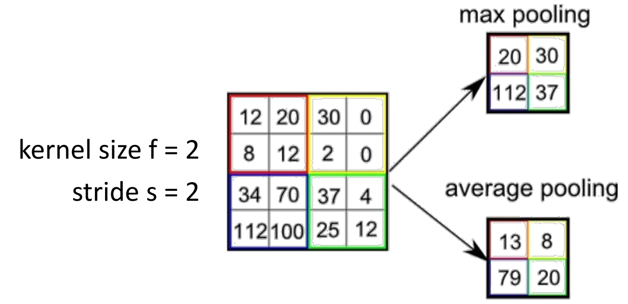
Pooling Layers
Pooling
Two main types of pooling
Max pooling is usually preferred (keeps the most significant features)

Slide 34
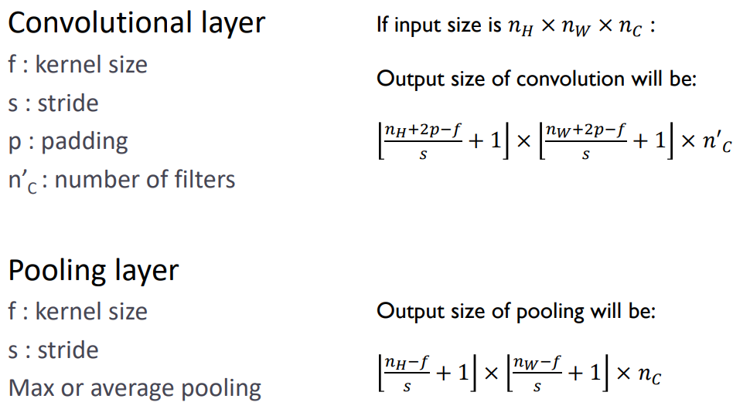
Pooling Layers
Hyperparameters

Slide 35
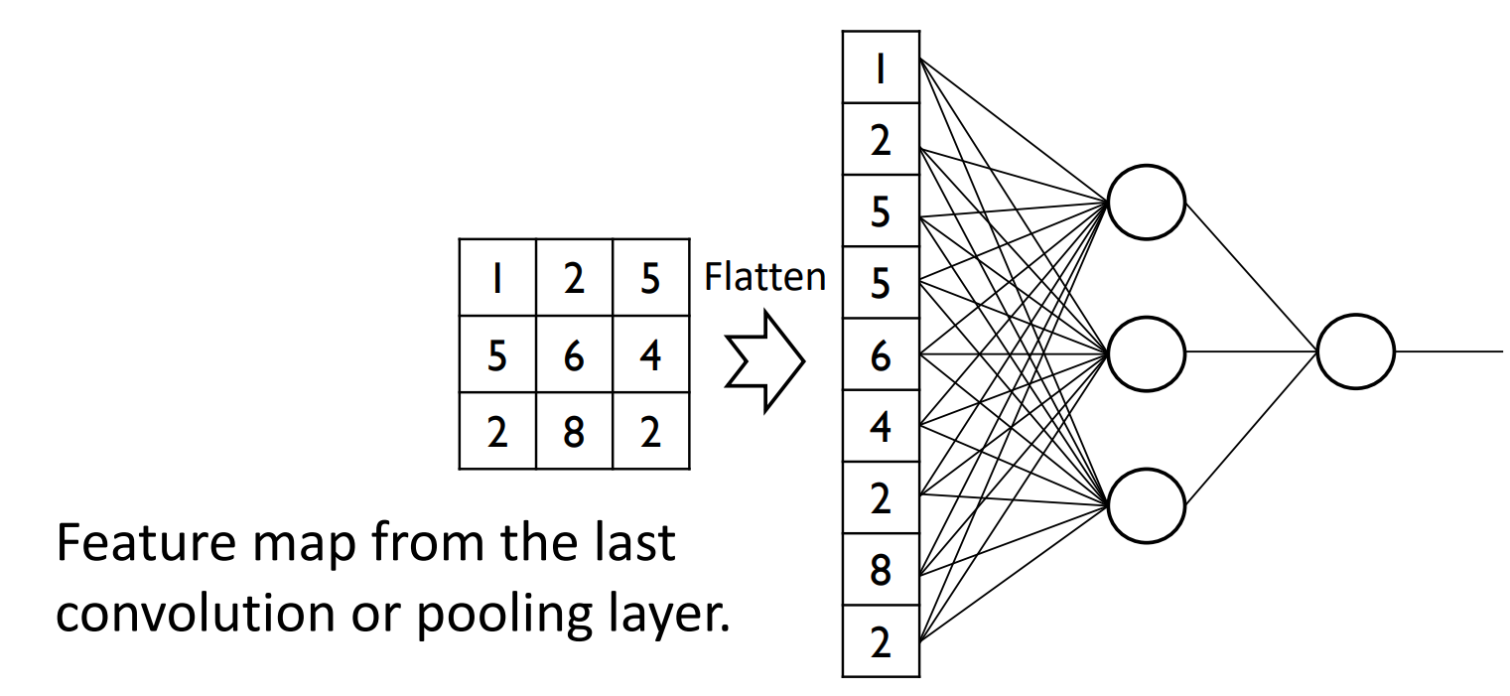
Linear Layers
Fully Connected Layer
For Classification:

Slide 36
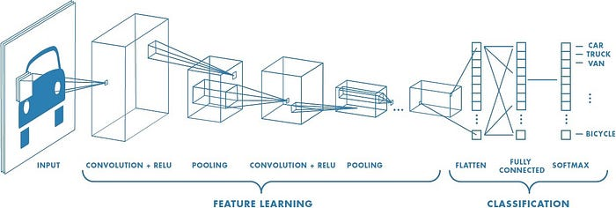
CNNs
Putting it all Together
https://towardsdatascience.com/a-comprehensive-guide-to-convolutional-neural-networks-the-eli5-way-3bd2b1164a53

Slide 37
Outline
Background
Convolution
CNN components: convolutional layers, pooling layers
CNN architectures

Slide 38
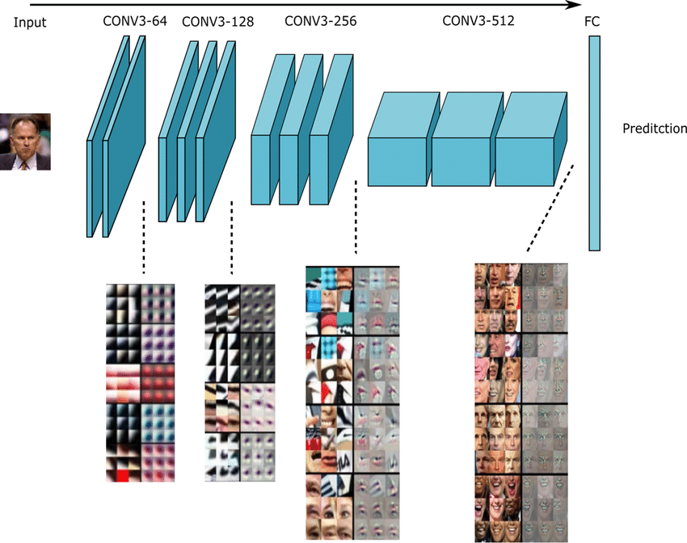
CNNs
Deep Representations
Composition of convolutional layers allows these models to learn increasingly complex visual features
Biological vision systems do this

Slide 39
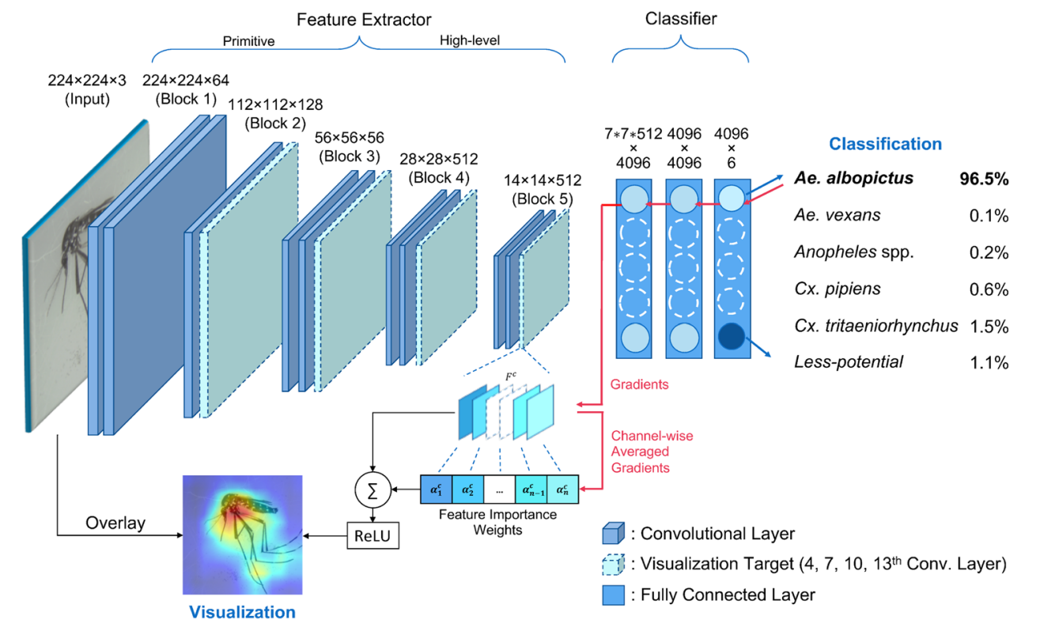
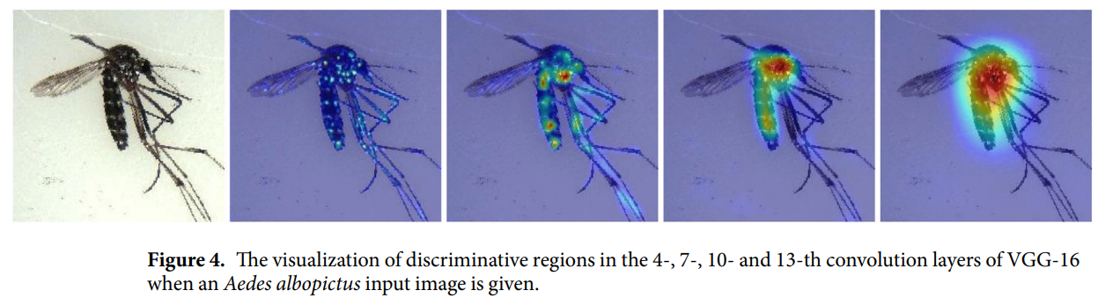
CNNs
Visualising Deep Representations
Classifcation and Morphological Analysis of Vector Mosquitoes using Deep Convolutional Neural Networks, Park et al. 2020, Nature Scientific Reports

Slide 40
CNN architectures
CNN architectures
CNN architectures are effectively a combination of the previous building blocks
This is largely an engineering problem
Architectures are often effective across diverse domains

Slide 41
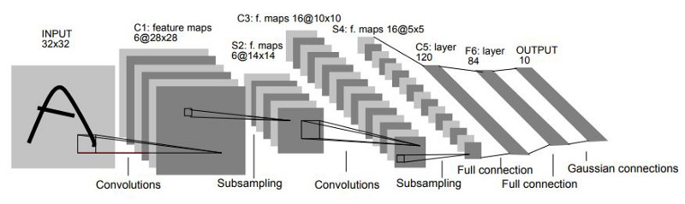
CNN architectures
LeNet-5 (1998)
Designed for handwritten digit recognition (MNIST)
60k parameters
LeCun, Y., Bottou, L., Bengio, Y., & Haffner, P. (1998). Gradient-based learning applied to document recognition. Proceedings of the IEEE, 86(11), 2278-2324.

Slide 42
CNN architectures
LeNet-5 (1998)
Convolution kernels: kernel size f = 5 (5x5), stride s =1
Pooling layers: kernel size f = 2 (2x2), stride s = 2
LeCun, Y., Bottou, L., Bengio, Y., & Haffner, P. (1998). Gradient-based learning applied to document recognition. Proceedings of the IEEE, 86(11), 2278-2324.

Slide 43
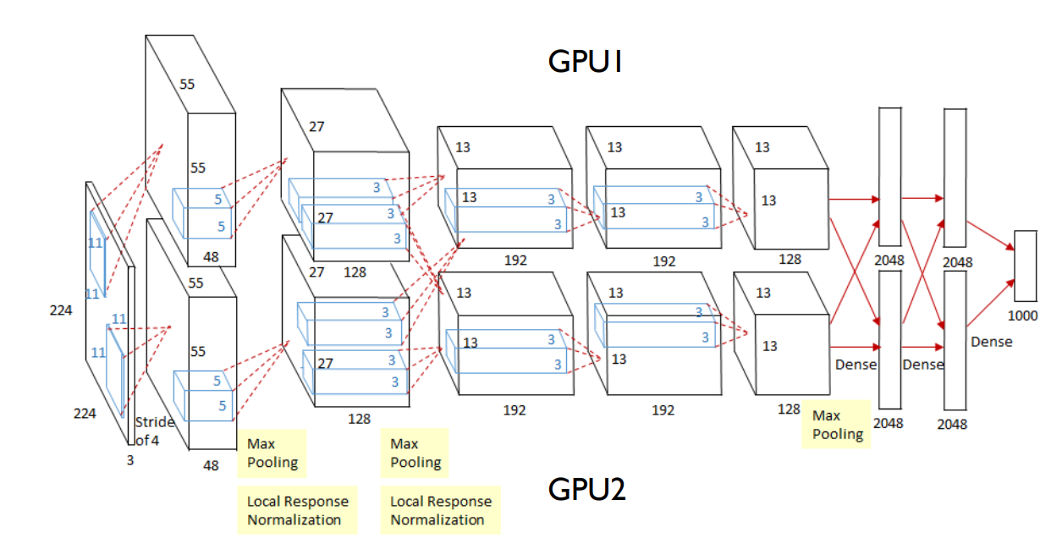
CNN architectures
AlexNet (2012)
Run on two GPUs due to memory constraints
60 million parameters
Krizhevsky, A., Sutskever, I., & Hinton, G. E. (2012). Imagenet classification with deep convolutional neural networks. Advances in neural information processing systems, 25.

Slide 44
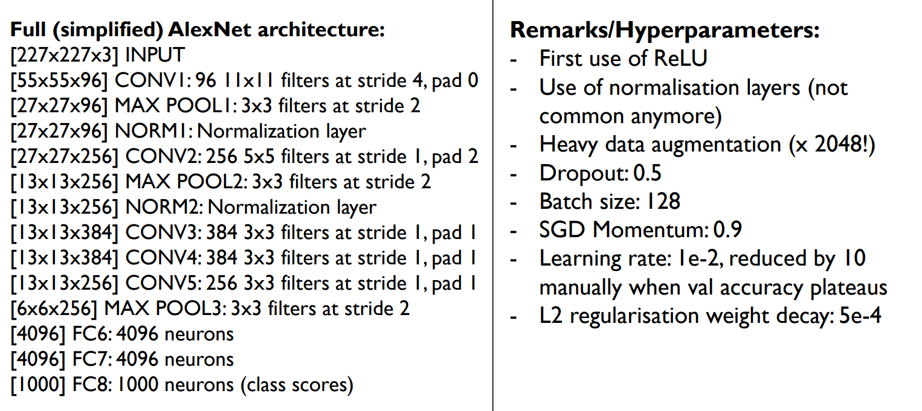
CNN architectures
AlexNet (2012)
Krizhevsky, A., Sutskever, I., & Hinton, G. E. (2012). Imagenet classification with deep convolutional neural networks. Advances in neural information processing systems, 25.

Slide 45

CNN architectures
ImageNet Classification Challenge
Competition to achieve the highest accuracy on a visual classification dataset
>1m images
1000 classes
https://image-net.org/challenges/LSVRC/

Slide 46
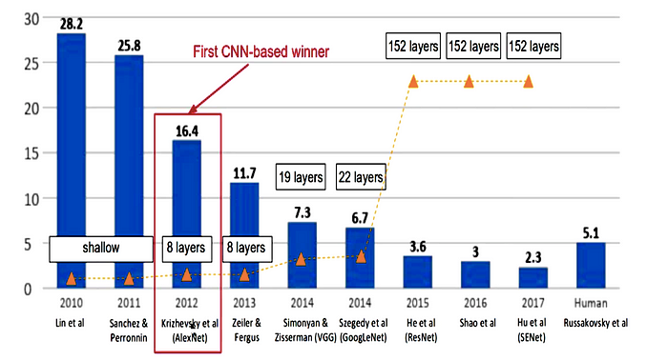
CNN architectures
ImageNet Classification Challenge
https://medium.com/appyhigh-technology-blog/convolutional-neural-networks-a-brief-history-of-their-evolution-ee3405568597

Slide 47
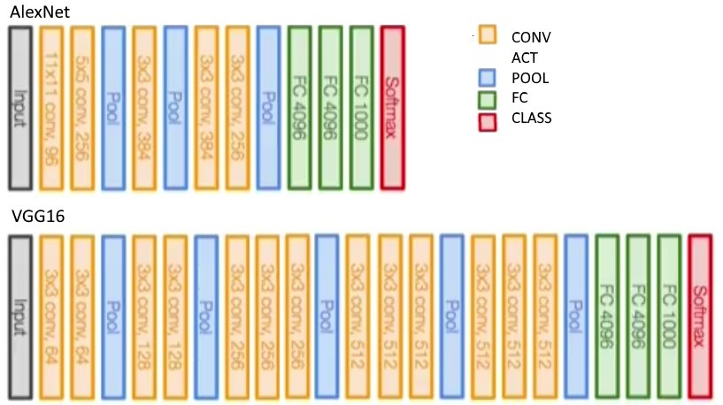
CNN architectures
VGGNet (2014)
Small filters
Stack of small filters have the same effect than one larger one
More layers
More non-linearities
More abstract feature representations
However, adding more layers than this would hurt performance…

Slide 48
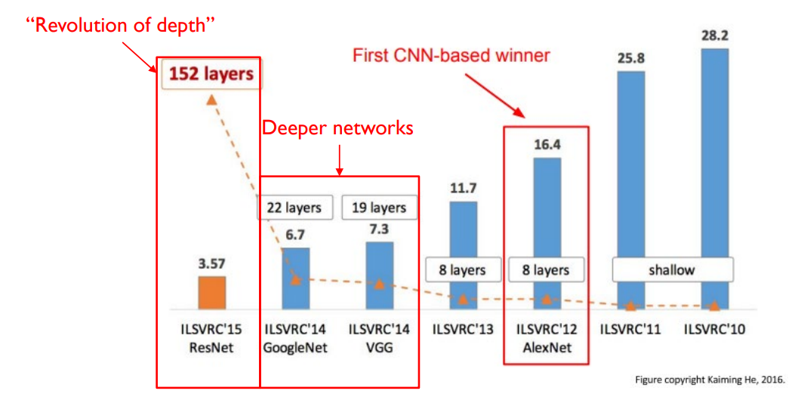
CNN architectures
ResNet (2015)

Slide 49
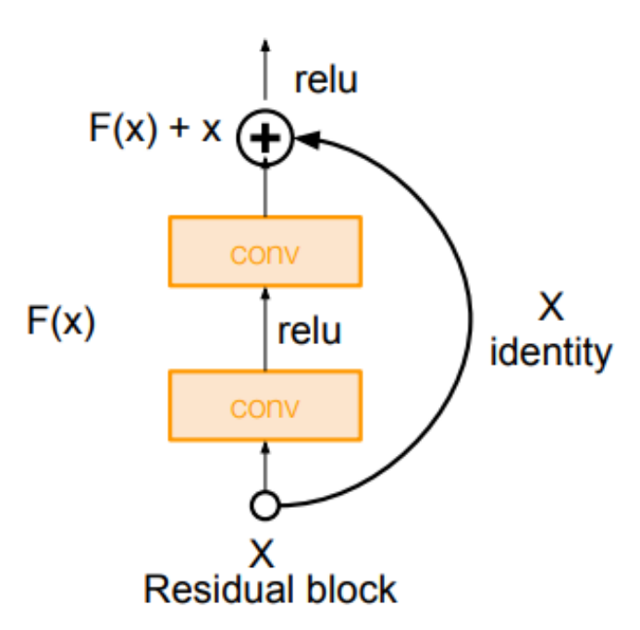
CNN architectures
ResNet (2015)
Main novelty: residual connections
Architecture consists of residual blocks

Slide 50
CNN architectures
ResNet (2015)
Why? Deeper networks!
Training deep networks is hard
Vanishing gradient problem
Composition of many functions is difficult to optimise
Residual blocks offer a skip/shortcut
We only need to learn deviation from the identity
Commonly used in most deep architectures

Slide 51
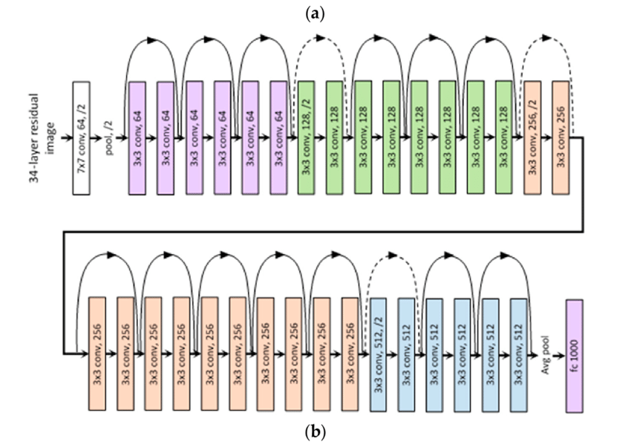
CNN architectures
ResNet (2015)

Slide 52
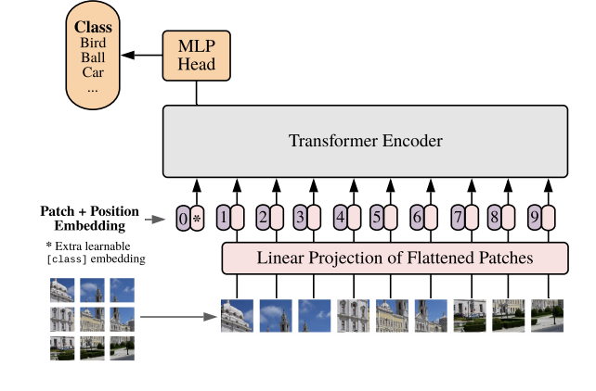
Vision Transformers (2020)
Not a CNN: Original implementation avoids convolutions
Attention and positional encoding allows interactions across entire image, without needing to build a receptive field like CNNs
Dosovitskiy, A., Beyer, L., Kolesnikov, A., Weissenborn, D., Zhai, X., Unterthiner, T., ... & Houlsby, N. (2020). An image is worth 16x16 words: Transformers for image recognition at scale. arXiv preprint arXiv:2010.11929.

